Slide 1


ACT® Aspire®
Personal Needs Profile in PearsonAccess^{next}
Notes:
Welcome to the ACT® Aspire® Personal Needs Profile in PearsonAccess^{next} training. This training explains the need for a Personal Needs Profile (PNP) and the steps required for creating and editing the PNP in PearsonAccess^{next}.

Slide 2




Agenda
Personal Needs Profile
Editing Student Records to add PNP
ACT Aspire Accommodations and Supports Resources
Notes:
During the training, we’ll review the purpose of a Personal Needs Profile, editing a student record to add the PNP, and ACT Aspire Accommodations and Supports Resources available.

Slide 3

Personal Needs Profile
Notes:
In ACT Aspire, any student - with or without an identified disability - may use Accessibility Supports that appropriately match the student’s needs. The Personal Needs Profile is used to assign Accessibility Supports in PearsonAccess^{next} for use in TestNav.

Slide 4
Personal Needs Profile
Types of Accessibility Supports
Universal Supports
Designated Supports
English Learner (EL) Supports
Accommodations
Notes:
Those with Test Coordinator permissions in PearsonAccess^{next} must select accommodations through the online Personal Needs Profile (PNP) process in PearsonAccess^{next} prior to a student beginning to test.
Accessibility Supports permitted during testing are designed to remove barriers to student access to the test and do not alter the validity of the test, test constructs, score interpretation, reliability, or security of the test. It is recommended that students who use accommodations have a formally documented need as well as relevant knowledge and familiarity with the available tools.
Accessibility Supports available on ACT Aspire include Universal Supports, Designated Supports, English Learner (EL) Supports, and Accommodations. It is recommended that students use the tutorial and online exemplars to learn how to navigate online tools before testing.

Slide 5
Personal Needs Profile
Universal Supports
Universal Supports for Online Tests | Universal Supports for Online and Paper Tests
Answer / Custom Masking | Answer Eliminator
Color Contrast / Overlay | Scratch Paper
Countdown Timer
Keyboard Navigation
Highlighter
Magnification / Magnifier
Mark Item for Review
Notes:
Universal Supports are available to all students based on student preference and selection and do not require a Personal Needs Profile (PNP).
Students whose needs are met by default embedded tools do not need a PNP.
For paper testing, Universal Supports are approved by the Test Coordinator. For online testing, Universal Supports are available to all students in TestNav without requiring approval.
The Universal Supports available are shown on this slide.

Slide 6
Personal Needs Profile
Designated Supports
Designated Supports for Paper Tests | Designated Supports for Online and Paper Tests
Answer / Custom Masking | Audio Amplification / FM System
Color Contrast / Overlay | Food, Drink, Medication for Medical Need
Countdown Timer | Home / Hospital Testing
Highlighter | Notification of Time Remaining
Magnification / Magnifier | Preferential Seating
Mark Item for Review | Printed Copy of Verbal Instructions
 | Visual Environment
Notes:
Designated Supports are available to any student for whom a need has been identified. Designated Supports must be identified and planned for locally to ensure proper delivery. Some supports may need to be entered in PearsonAccess^{next} on the student's PNP if they are listed on the PNP screen.
The Designated Supports available are shown on this slide.

Slide 7
Personal Needs Profile
English Learner (EL) Supports
English Learner (EL) Supports for Online and Paper Tests
ACT-Authorized Bilingual Word-to-Word Dictionaries
Translated Verbal Instructions
Extra Testing Time
Small Group Testing
Notes:
English learner (EL) supports are available only for examinees who are not proficient in English.
EL supports are limited to: ACT-authorized bilingual word-to-word dictionary, translated verbal instructions (provided locally), extra testing time, and small group testing.

Slide 8
Personal Needs PRofile
Accommodations
Accommodations for Online and Paper Tests
Extra Time (150%-400% of Standard Time) | Sign language interpreter
Audio supports | Alternate formats
Response supports
Notes:
Accommodations are available only for students with disabilities as documented in an Individualized Education Program (IEP) or 504 Plan. Students with accommodations must use the designated
accommodations test materials. Students with the same testing times should test together as a group unless an accommodation requires one-to-one testing.
Examples of accommodations include, but are not limited to:
• Timing/scheduling supports (e.g., extra testing time, breaks as needed [other than using the restroom])
• Audio supports (e.g., human reader, text-to-speech)
• Response supports (e.g., scribe to record responses, speech-to-text software for the writing test)
• Sign language interpreter
• Alternate formats (e.g., braille, large print)

Slide 9
Personal Needs Profile
Accommodations
Accommodations that Require ADE Approval
Regular Print Paper Test in a Computer-Based Testing School
Large Print Test
Braille Test
Computer-Based Test in a Paper-Based Testing School
ASL Full Translation
Speech-to-Text
Notes:
Accommodations that require ADE approval include:
Regular print paper test in a Computer-Based Testing school
Large print test
Braille test
Computer-Based Test in a Paper-Based Testing school
American Sign Language (ASL) Full Translation for Math, Science, and Writing (This accommodation requires a paper test and a one-on-one test administration. ASL Full Translation is not available for the English and Reading test sections. ASL translation of the verbal instructions only does not require ADE approval.)
Speech-to-Text (requires a paper test and a one-on-one test administration)

Slide 10
Edit Student Records to Add PNP
Notes:
Now, we will look at editing student records in PearsonAccess^{next} (PAN) to add a PNP. This process is used to update data in PearsonAccess^{next} for students that are already loaded in PAN. A student’s PNP must be updated before they are placed in test sessions.

Slide 11
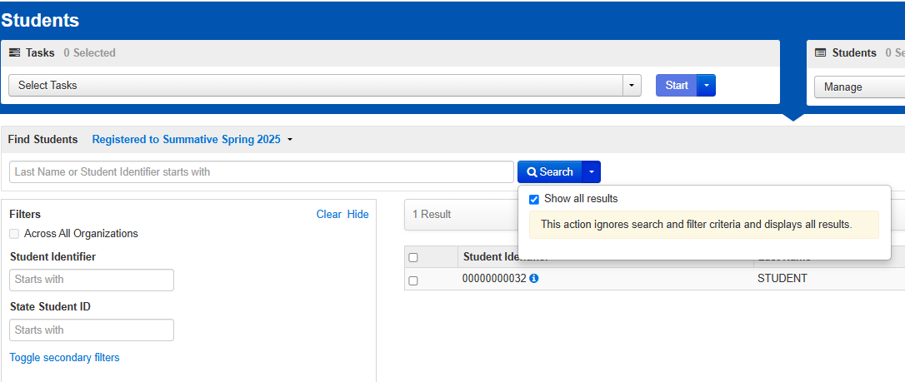
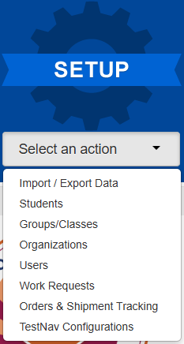
Edit Student Records
Editing Personal Needs Profile
Notes:
To edit a student record, select “Students” from the “Setup” menu on the PearsonAccess^{next} home screen.
Next, on the “Students” page, you can use the filters to find a specific student or click on the “Search” dropdown arrow and check the “Show all results” check box.

Slide 12

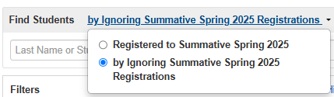
Edit Student Records
Editing Personal Needs Profile
Notes:
If you do not find the student using the search filters or using “Show all results,” the student either has not been created in PearsonAccess^{next}, or their registration is incomplete. The default view on the “Students” page is to show students that have complete registrations.
To view students with incomplete registrations, use the “Find Students” dropdown to select the “by Ignoring Summative Spring Current Year Registrations” radio button.

Slide 13
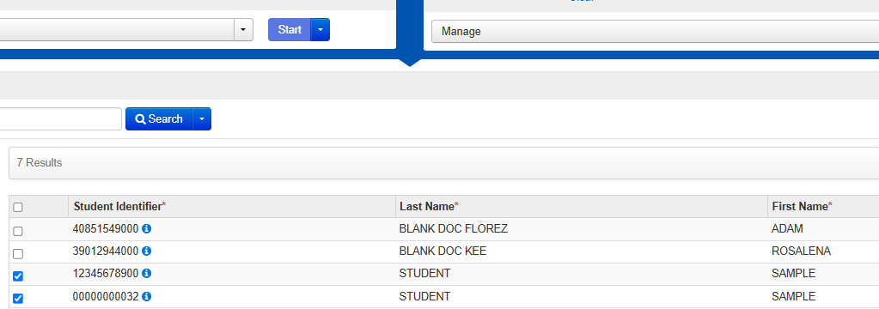
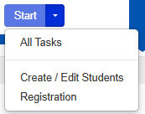
Edit Student Records
Editing Personal Needs Profile
Notes:
Place a checkmark in the check box for each student that requires an update to their PNP and then click “Start>All Tasks”.

Slide 14
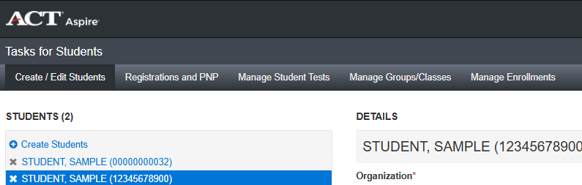
Edit Student Records
Tasks for Students Page
Notes:
On the “Tasks for Students” page, select the “Registrations and PNP” tab.

Slide 15
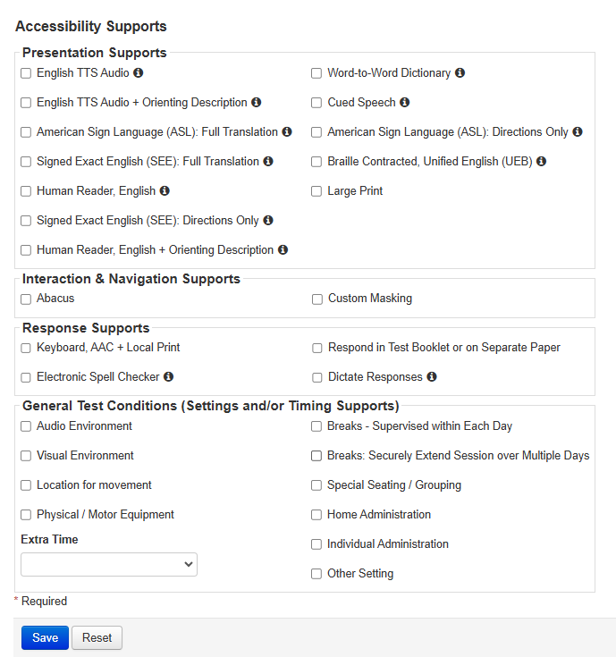
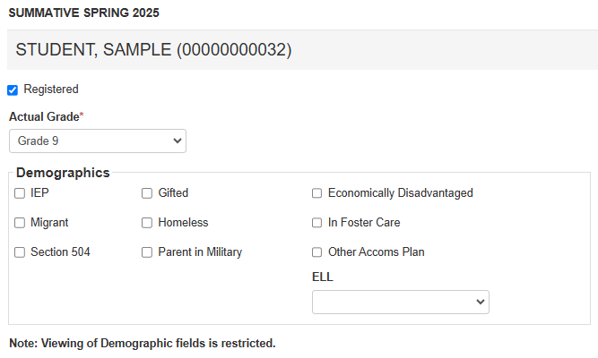
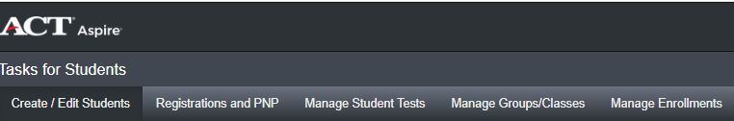
Edit Student Records
Registrations and PNP
Notes:
Review the “Demographics” options and place a check in the checkbox for any that apply.
Continue to scroll down the page to select the appropriate Accessibility Supports for the students if needed. These are not required fields. Click “Save” when complete.

Slide 16
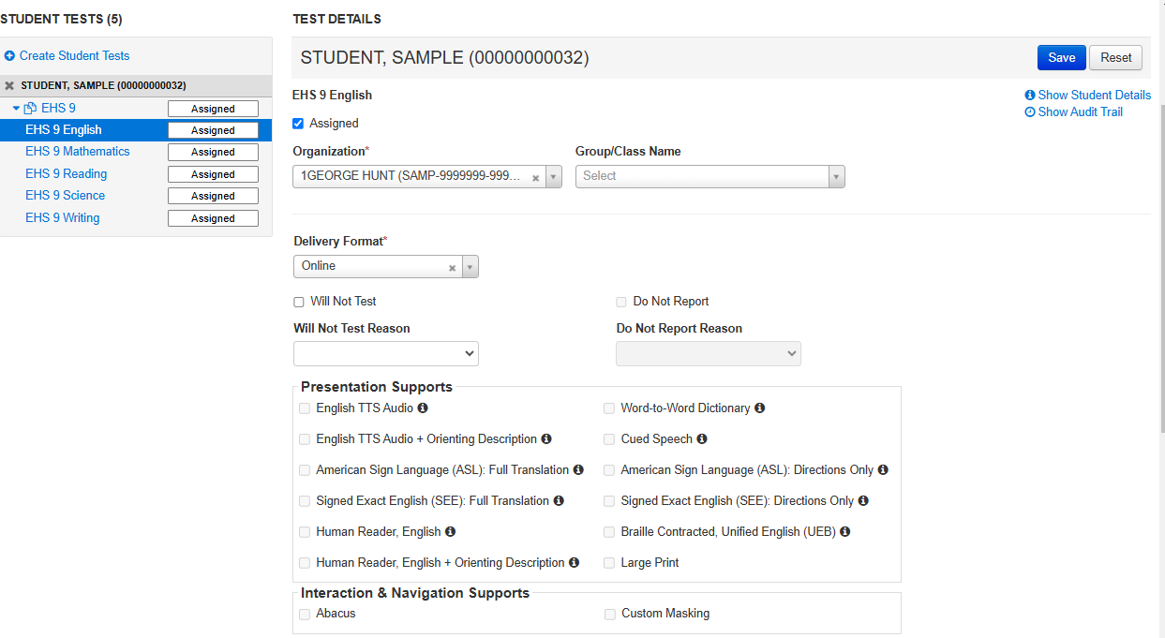
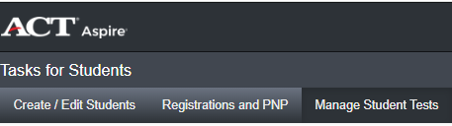
Edit Student Records
Manage Student Tests
Notes:
Accessibility Supports selected on the “Registrations and PNP” tab will be applied to a test if applicable.
To review which tests the Accessibility Supports will apply to, go to the Manage Student Tests Tab, then click on each test in the “Student Tests” menu to review the Accessibility Supports for the student.
The Accessibility Support options are Read Only on this page. Any edits to a student’s PNP must be applied in the “Registrations and PNP” tab.
If Text-to-Speech is selected for a student, it will be applied along with 300% Extra Time, to the Writing, Math, and Science test sections only. If the student also requires extra testing time for the Reading and English test sections, go back to the “Registrations and PNP” tab to assign the extra time.
Text-to-Speech and Extra Time accommodations must be saved to a student’s PNP before the student is moved to test sessions or it will not be available for the student when they log into their test in TestNav.

Slide 17
ACT® Aspire® accommodations and supports Resources
Notes:
Now we will discuss resources available for ACT Aspire Accommodations and Supports.

Slide 18
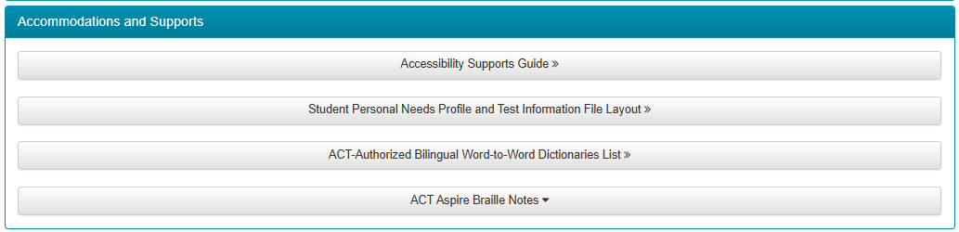
Resources
Web pages and Resources
Arizona ACT Aspire Support Page
https://az-support.mypearsonsupport.com/aspire/
Notes:
The Arizona ACT Aspire Support Page contains useful resources with detailed information about Accommodations and Supports, including the ACT Aspire Accessibility Supports Guide.
We suggest bookmarking the Arizona ACT Aspire Support Page for future reference.

Slide 19

Questions? We’re here to help!
Pearson Customer Support
Phone: 1.888.705.9421 Option 4 (ACT Aspire), 7:00 a.m. – 7:00 p.m., central time, Monday through Friday
Notes:
This concludes the ACT Aspire Personal Needs Profile in PearsonAccess^{next} training. If you have any questions, please contact us at the number provided on this slide.

